Slide 1
Credit Card Fraud Detection
Team Members: Anupama Singh, Smruti Singh

Slide 2

?
Problem Statement
How can we accurately detect fraudulent credit card transactions using machine learning — without blocking genuine customers?
These days, fraudsters keep finding new tricks to fool credit card systems using stolen cards or fake purchases. Old fraud detection methods often fail because of two big problems:
❌
Missing real fraud (letting fraud slip through)
❌
False alarms (blocking good customers)
Why this was worth investigating?
We took inspiration from JPMorgan Chase AI Research, who released synthetic financial transaction data and published two key research papers that shaped our direction:
Assefa, S., Sharma, A., & Wang, C. (2020). Generating Synthetic Data in Finance: Opportunities, Challenges and Pitfalls. JPMorgan AI Research.
Generating Synthetic Data in Finance
→ Highlighted the limits of synthetic datasets that miss real human behavior.
Borrajo, D., & Veloso, M. (2020). Domain-independent Classification of Behavior Traces. SSRN.
Behavior Trace Classification
→ Emphasized the need to detect fraud based on sequential behavior and intent, not just transaction size.

Slide 3


What we did
To solve this, we built a fraud detection system using real behavioral features:
How often and how quickly someone is transacting (velocity)
Whether their device or IP changed suddenly
Timing (weekends, night-time), and previous fraud patterns
We trained and compared multiple machine learning models, including Random Forests, Gradient Boosting (XGBoost), and LSTM (deep learning for sequences). We visualized which features trigger fraud detection and scored new scenarios in real time.
Why this matters
This research bridges the gap between technical accuracy and real-world usability:
It's designed to prevent loss from fraud
While reducing false flags on honest customers
And it’s simple enough to explain to business teams and integrate into production

Slide 4



Data
Target variable (What we’re predicting)
Name
Type
Meaning
Values
Fraud Label
Integer
Whether the transaction is fraud
0 = Safe, 1 = Fraudulent
Input variables (What the model learns from)
Name
Type
Meaning
Values
Is_Weekend
Categorical (Binary)
Whether the transaction happened on a weekend
0 = Weekday, 1 = Weekend
Velocity_1hr
Continuous
Number of transactions in the past 1 hour
0.0, 1.5, 12.0, 30.0
Risk_Score
Categorical (Binary)
Risk score of the transaction (0 = safe, 1 = risky)
0.1, 0.45, 0.78, 0.95
Transaction_Distance
Continuous
Distance from previous known transaction location
0.0, 100.0, 3000.0 (in meters/km)
Device_Change_Flag
Categorical (Binary)
Whether user changed device recently
0 = No Change, 1 = Changed Device

Slide 5




Methodology
Data Preparation
Trained Multiple Models
Select Best Model
Explain Predictions
Simulated Real Scenarios
Cleaned and transformed raw data.
Enabled the model to detect behavior patterns, including:
Device changes
Sudden spending spikes
Unusual transaction times
We used metrics like Precision, Recall, and AUC to find the best performer. Random Forest came out on top:
Highly accurate
Easy to explain
Ideal for real-time fraud detection
We created visualizations showing what the model is focusing on:
Changes in device or IP
High velocity of transactions
Risk scores
Weekend transactions
We scored example transactions (Safe, Suspicious, Fraud) and showed what the model would do — like a smart fraud filter in action.
Random Forest
XGBoost
XGBoost + SMOTE
LSTM
Reliable, fast, and very explainable
High performance, great at spotting complex fraud
Helps when fraud examples are rare
Remembers behavior patterns over time

Slide 6
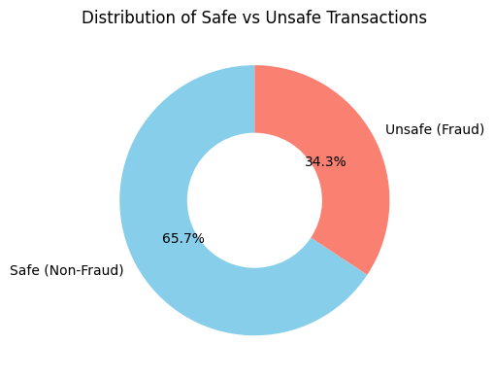
Exploratory Data Analysis Results
Safe vs Unsafe Transaction Distribution (Pie Chart)
66% of transactions were safe — no fraud involved
34% were unsafe (fraud) — and needed to be caught
Our dataset is balanced, giving the model a fair view of both safe and fraudulent behaviours
This balance helps the model learn the difference more accurately
Real-world fraud cases are rare — but in this project, we ensured enough fraud signals so the model could learn to detect them effectively

Slide 7
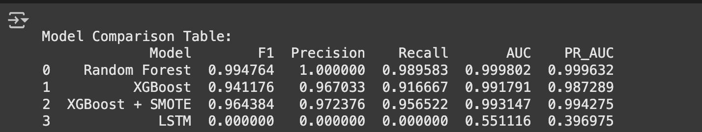
Evaluation Metrics
Random Forest:
Perfect Precision (1.0) — no false alarms. | High Recall (0.98) — caught almost all fraud | Best for real-time use & explainability
XGBoost:
Great at spotting complex fraud | Recall slightly lower (0.91) — missed a few | Faster & scalable for larger data
XGBoost + SMOTE:
Balanced class imbalance (fraud cases were fewer) | Recall improved over plain XGBoost
LSTM:
Did not perform well on this dataset | Needs longer time-based data to learn sequences

Slide 8
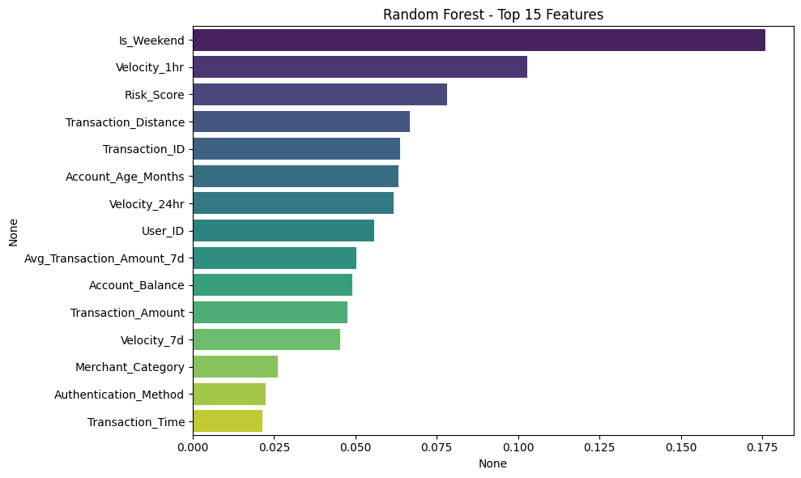
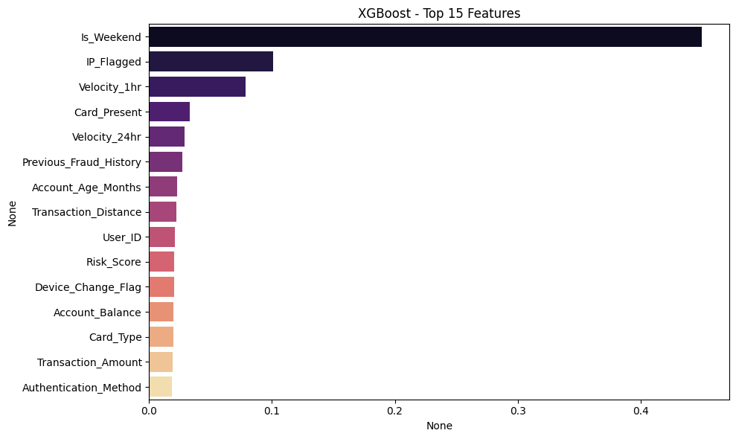
Feature Importance – What the Model Pays Attention To
Random Forest Feature Plot
XGBoost Feature Plot

Slide 9

Feature Importance – What the Models Pay Attention To
Goal: Understand which features influence the model’s fraud detection decisions the most.
🗓️ Weekend transactions were the biggest red flag - fraud often spikes on weekends.
🚀 Velocity (how fast someone is transacting) is very important, many transactions in a short time could mean suspicious behaviour.
🔁 Device or IP changes alert the model - if someone suddenly logs in from a new device, it raises suspicion.
🧠 XGBoost model focused more on unusual technical signals like IP_Flagged and Card_Present.
🤝 Random Forest paid attention to behaviour over time, like account age, transaction distance, and user’s history.
Common Key Features:
Both models heavily rely on:
Is_Weekend, Velocity_1hr, Account_Age_Months, and User_ID.

Slide 10
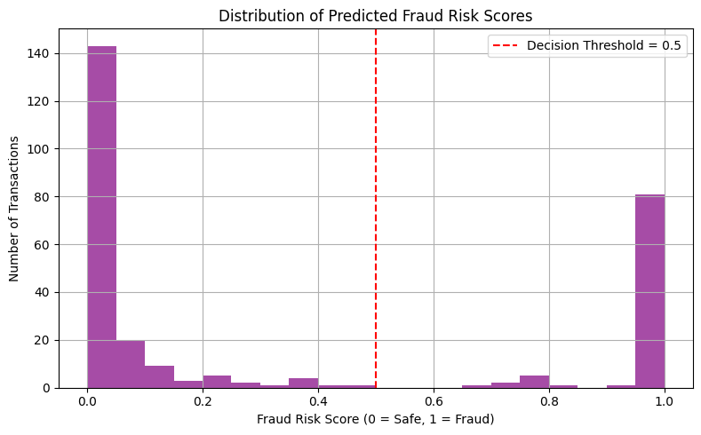
Fraud Risk Score Histogram (All Transactions)
This histogram shows the distribution of predicted fraud risk scores for all transactions.
X-axis: Risk score (0 = Safe, 1 = Fraud), Y-axis: Number of transactions.
A clear bimodal distribution:
Majority of transactions have scores near 0 (safe) or 1 (fraud).
Very few transactions fall in the uncertain mid-range (0.4–0.6).
The red dashed line at threshold = 0.5 marks the decision boundary used to classify fraud.
Interpretation:
The model is confident in most predictions, as scores are polarized.
Low overlap around threshold = less ambiguity, aiding better classification.

Slide 11
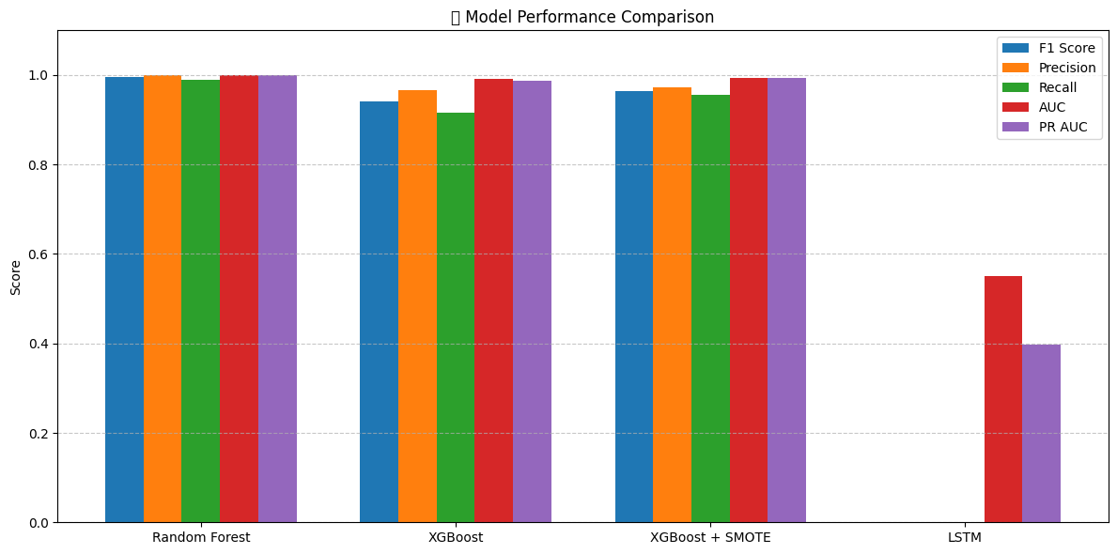
Model Comparison Plot
✅ Random Forest performed the best
It accurately separated safe and unsafe transactions with 99% precision.
Great for minimizing false alerts while still catching fraud.
📈 XGBoost + SMOTE worked well too
Slightly better at catching rare fraud cases (high recall).
Balanced model, helpful for highly imbalanced data like fraud detection.
⚠️ Plain XGBoost missed more frauds
Lower recall compared to SMOTE-enhanced version.
Shows why rebalancing (like SMOTE) is important in fraud datasets.
❌ LSTM (deep learning) struggled
Very low performance on this type of data.
Our dataset isn’t sequential (like time series), so it wasn’t the right fit.

Slide 12
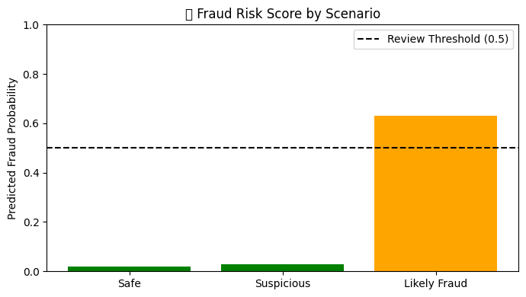
Real-Life Scenario Risk Scores (Bar Chart)
Real-World Testing of the Model (3 Sample Scenarios)
Scenario 1: Low-risk, everyday transaction → Customer used a known card on a weekday, no unusual patterns → Model confidently marked it safe (Fraud Risk: 0.02)
Scenario 2: Still low-risk but a bit unusual → Happened on a weekend and from a new device → Model still marked it safe (Fraud Risk: 0.03) but noticed subtle shifts
Scenario 3: Slightly suspicious behaviour → Weekend, changed device, and higher spending → Model flagged for manual review (Fraud Risk: 0.63)

Slide 13
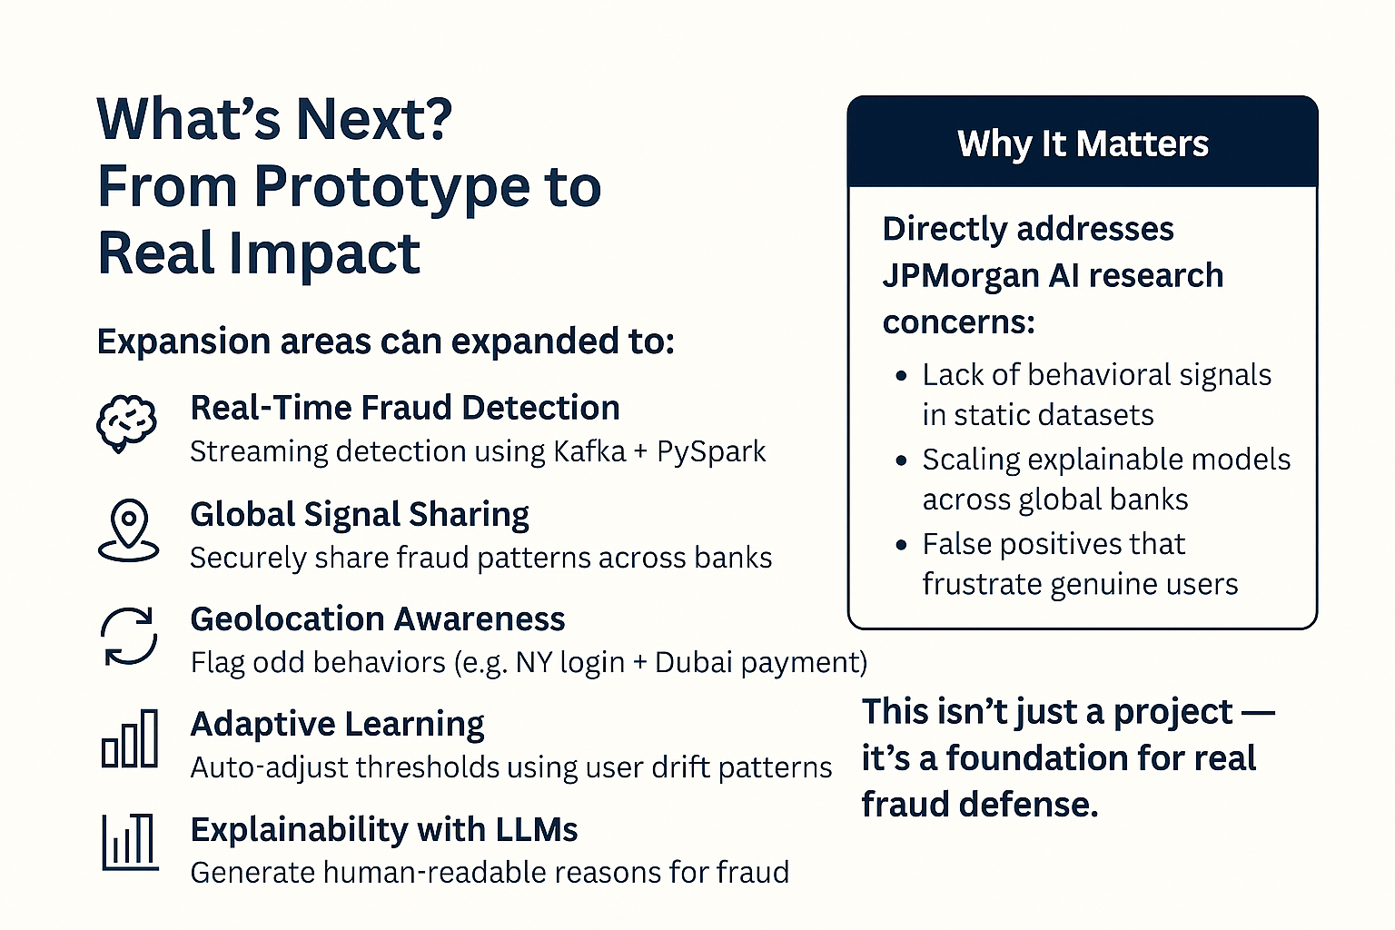
Future Scope
• JPMorgan Chase SIM-swap & location spoofing fraud (May 2023): businessinsider.com/credit-card-phone-theft-sim-swap-identity-theft-investigation-2023-4
• FCC SIM-swap fraud protection rules (Dec 2023): federalregister.gov/documents/2023/12/08/2023-26338/protecting-consumers-from-sim-swap-and-port-out-fraud

Slide 14
CONCLUSION

Slide 15
References
Ahmed, M., Mahmood, A. N., & Hu, J. (2022). Credit card fraud detection using genetic algorithms for feature selection. Journal of Big Data, 9(1), 1–24. https://journalofbigdata.springeropen.com/articles/10.1186/s40537-022-00573-8
2. Uddin, M. Z., et al. (2022). A hybrid machine learning approach for sensitive and recall-focused fraud detection. National Library of Medicine. https://pmc.ncbi.nlm.nih.gov/articles/PMC10535547/
3. Business Insider. (2023, May). Credit card phone theft: SIM-swap & location spoofing fraud – JPMorgan Chase investigation. https://www.businessinsider.com/credit-card-phone-theft-sim-swap-identity-theft-investigation-2023-4

Slide 16
THANK YOU

